Slide 1

Social Policy Issue Impacting Older Adult Population
Depression in Older Adults
By: Allie Ulness

Slide 2

What will be Discussed
Explanation and exploration of the issue
How the issue has directly impacted the older adult population
Current challenges with U.S. policy
Possible solutions for the U.S.
Comparing and contrasting with another country’s solutions

Slide 3

Explanation of the Issue
z
Suicide among elders is a major public health problem.
The CDC reported in 2004, that there were 5,198 suicides among those were 65 and older.
Depression is widely under-recognized and under-treated in older adults.
Notes:
Depression is one of the most common mental health problems in older adults. It negatively affects functioning, health outcomes, quality of life, and health care costs.
Depression is not a normal part of aging. Depression is a medical problem that affects many older adults and usually can be successfully treated. However, it is widely under-recognized and under-treated in older adults.
https://store.samhsa.gov/sites/default/files/d7/priv/sma11-4631-keyissues.pdf

Slide 4

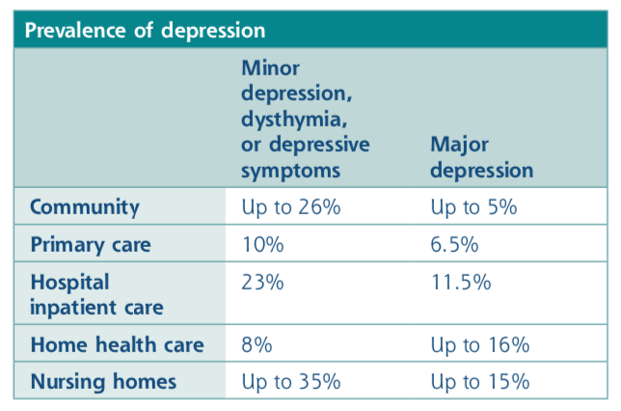
How Depression Directly Impacts the Elderly
z
Possible risk factors in correlation with depression in elders is the feeling of hopelessness, poor health/chronic pain, social isolation, loneliness, and more.
Signs of depression in elders can be easily missed by doctors and family.
Can be hard to recognize
Notes:
Depression is not a normal part of aging; however, it is common in older adults. Studies have shown that most older adults are satisfied with their lives. However, in times when things are changing, sickness, or losing a loved one can be factors contributing to an elder having depression. Moreover, depression in older adults can be hard to recognize, sadness is not their main symptom. It tends to be less obvious symptoms of depression, and or elders do not feel comfortable talking about their feelings.
Depression, especially minor depression and dysthymia, is under-recognized and under-treated. As such, the prevalence of depression may actually be higher than these estimates. In addition, the prevalence of major depression doubles after
age 80 years (Alexopoulos, 2005).

Slide 5
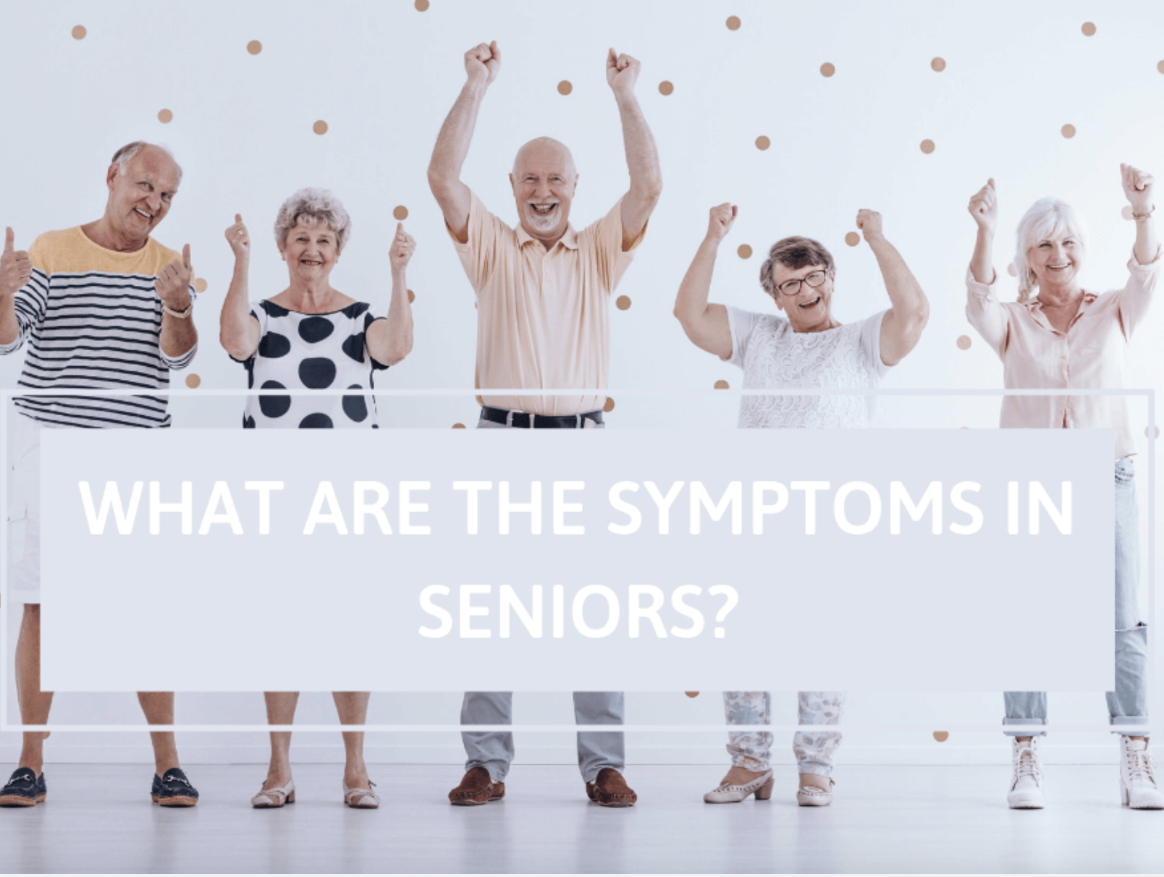
z
Changes in mood
Irritability and/or restlessness
Changes in appetite and/or weight
Less energy
Cognitive changes
Changes in sleeping patterns
Notes:
Changes in mood – These may include feelings of:
Anxiety
Sadness
Hopelessness
Pessimism
Guilt
Worthlessness
Helplessness
Irritability and/or restlessness – For instance, feeling that you can’t settle down to an activity or chore or feeling irritable over things that normally wouldn’t be problems for you.
Changes in appetite and/or weight – Food doesn’t taste as good as it used to. Even foods you particularly enjoy might be less pleasurable.
Less energy – Your energy levels may feel lower, leaving you too lethargic for even small tasks and chores.
Cognitive changes – For instance, difficulty making decisions, concentrating on tasks, and remembering details
Changes in sleeping patterns – Such as difficulty falling asleep or waking earlier than usual
https://successtms.com/blog/elderly-depression-symptoms

Slide 6

Challenges with the U.S. Policies
Depression in elders is not normally/easily recognized
Cost of untreated depression in elders
Elders reluctant to go to mental health specialist
The public health, mental health, and aging services networks need to work together more closely to reach and treat older adults with depression
Notes:
ageism and erroneous assumptions that depression is a normal part of aging may cause practitioners to miss a potential depression diagnosis.
Living with untreated depression presents a serious public health problem. Depression complicates chronic conditions such as heart disease, diabetes, and stroke; increases health care costs; and often accompanies functional impairment and disability
The researchers found those with depression and chronic disease had significantly higher total health care costs than those with chronic disease but no depression ($22,960 vs. $11,956) (Unützer, 2009). Only a small proportion of the increased costs are from mental health specialty care.
One barrier is that many older adults and society itself tends to have a stigma against mental illness, viewing depression as a personal weakness or character flaw
Public health and agencies on aging can do this by creating partnerships and collaborative care programs to identify, reach, and treat older adults with depression. Such a collaborative approach would allow consistent information to be disseminated to each of these sector

Slide 7
Possible Solutions for the U.S.
z

Slide 8
Solutions
Routine, systematic screening can successfully identify adults who are depressed and direct them to appropriate treatment
Routine screenings: depression screening tools are the Geriatric Depression Scale, the Center for Epidemiologic Studies Depression Scale, and the Patient Health Questionnaire.
Reducing the stigma of elders having depression
CBT a psychotherapy
Notes:
Step toward addressing stigma would be for the public and practitioners to better understand that depression is common and treatable
psychotherapy focusing on clients’ patterns of thought and behaviors that induce a depressed mood The therapist educates the client on how to identify and change these thoughts and behaviors to relieve the depression symptoms.
https://www.cdc.gov/aging/pdf/cib_mental_health.pdf

Slide 9
Comparing and Contrasting with another Country: Spain
Depression is also considered a public health problem among the elderly
Primary care physicians nor specialists do not acknowledge the depression among elders so similar to the U.S.
More screening for depression is necessary
Like wise to the U.S. loneliness and social isolation are linked with higher rates of depression in the elderly
Notes:
https://www.ncbi.nlm.nih.gov/pmc/articles/PMC7251154/

Slide 10
References
Agüera-Ortiz, L., Claver-Martín, M., Franco-Fernández, M., López-Álvarez, J., Martín-Carrasco, M., Ramos-García, M., & Sánchez-Pérez, M. (2020, May 20). Depression in the ELDERLY. consensus statement of the SPANISH Psychogeriatric Association. Retrieved April 17, 2021, from https://www.ncbi.nlm.nih.gov/pmc/articles/PMC7251154/
Brown, G. K., Brown, L. M., Bhar, S. S., & Beck, A. T. (2008). Cognitive therapy for suicidal older adults. In D. Gallagher-Thompson, A. M. Steffen, & L. W. Thompson (Eds.), Handbook of behavioral and cognitive therapies with older adults. (pp. 135-150). Springer Science + Business Media. http://dx.doi.org.proxy.uwec.edu/10.1007/978-0-387-72007-4_9
Casarella, J. (2008, June 13). Depression in Older Adults. WebMD. https://www.webmd.com/depression/guide/depression-elderly

Slide 11
References Continued
National Institute of Aging. (2017). Depression and Older Adults. https://www.nia.nih.gov/health/depression-and-older-adults
Substance Abuse and Mental Health Services Administration. The Treatment of Depression in Older Adults: Depression and Older Adults: Key Issues. HHS Pub. No. SMA-11-4631, Rockville, MD: Center for Mental Health Services, Substance Abuse and Mental Health Services Administration, U.S. Department of Health and Human Services, 2011.
Zhou, W., Chen, D., Hong, Z. et al. (2020). The relationship between health promoting lifestyles and depression in the elderly: roles of aging perceptions and social support. Qual Life Res 30, 721–728 https://doi-org.proxy.uwec.edu/10.1007/s11136-020- 02674-4

