Slide 1


MY NAME
ALLIE ULNESS

Slide 2
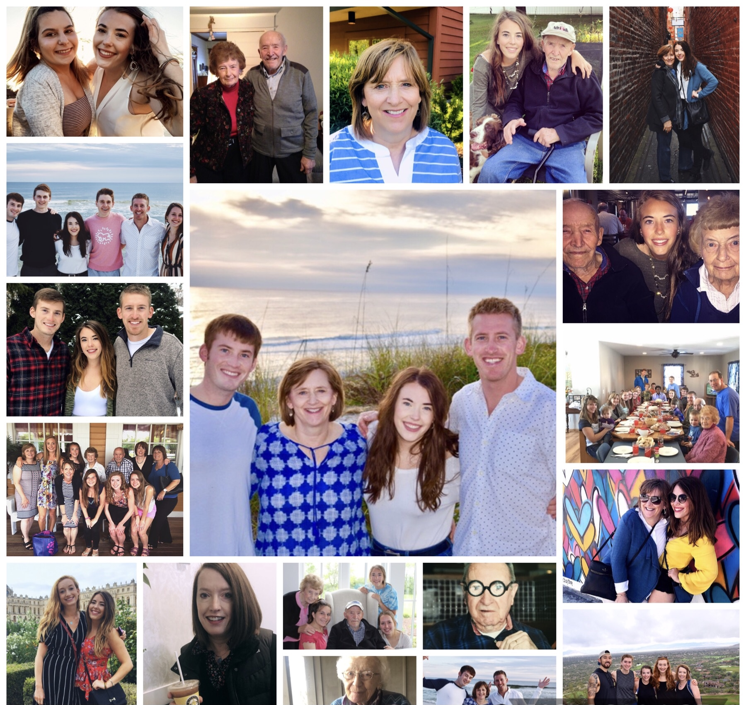
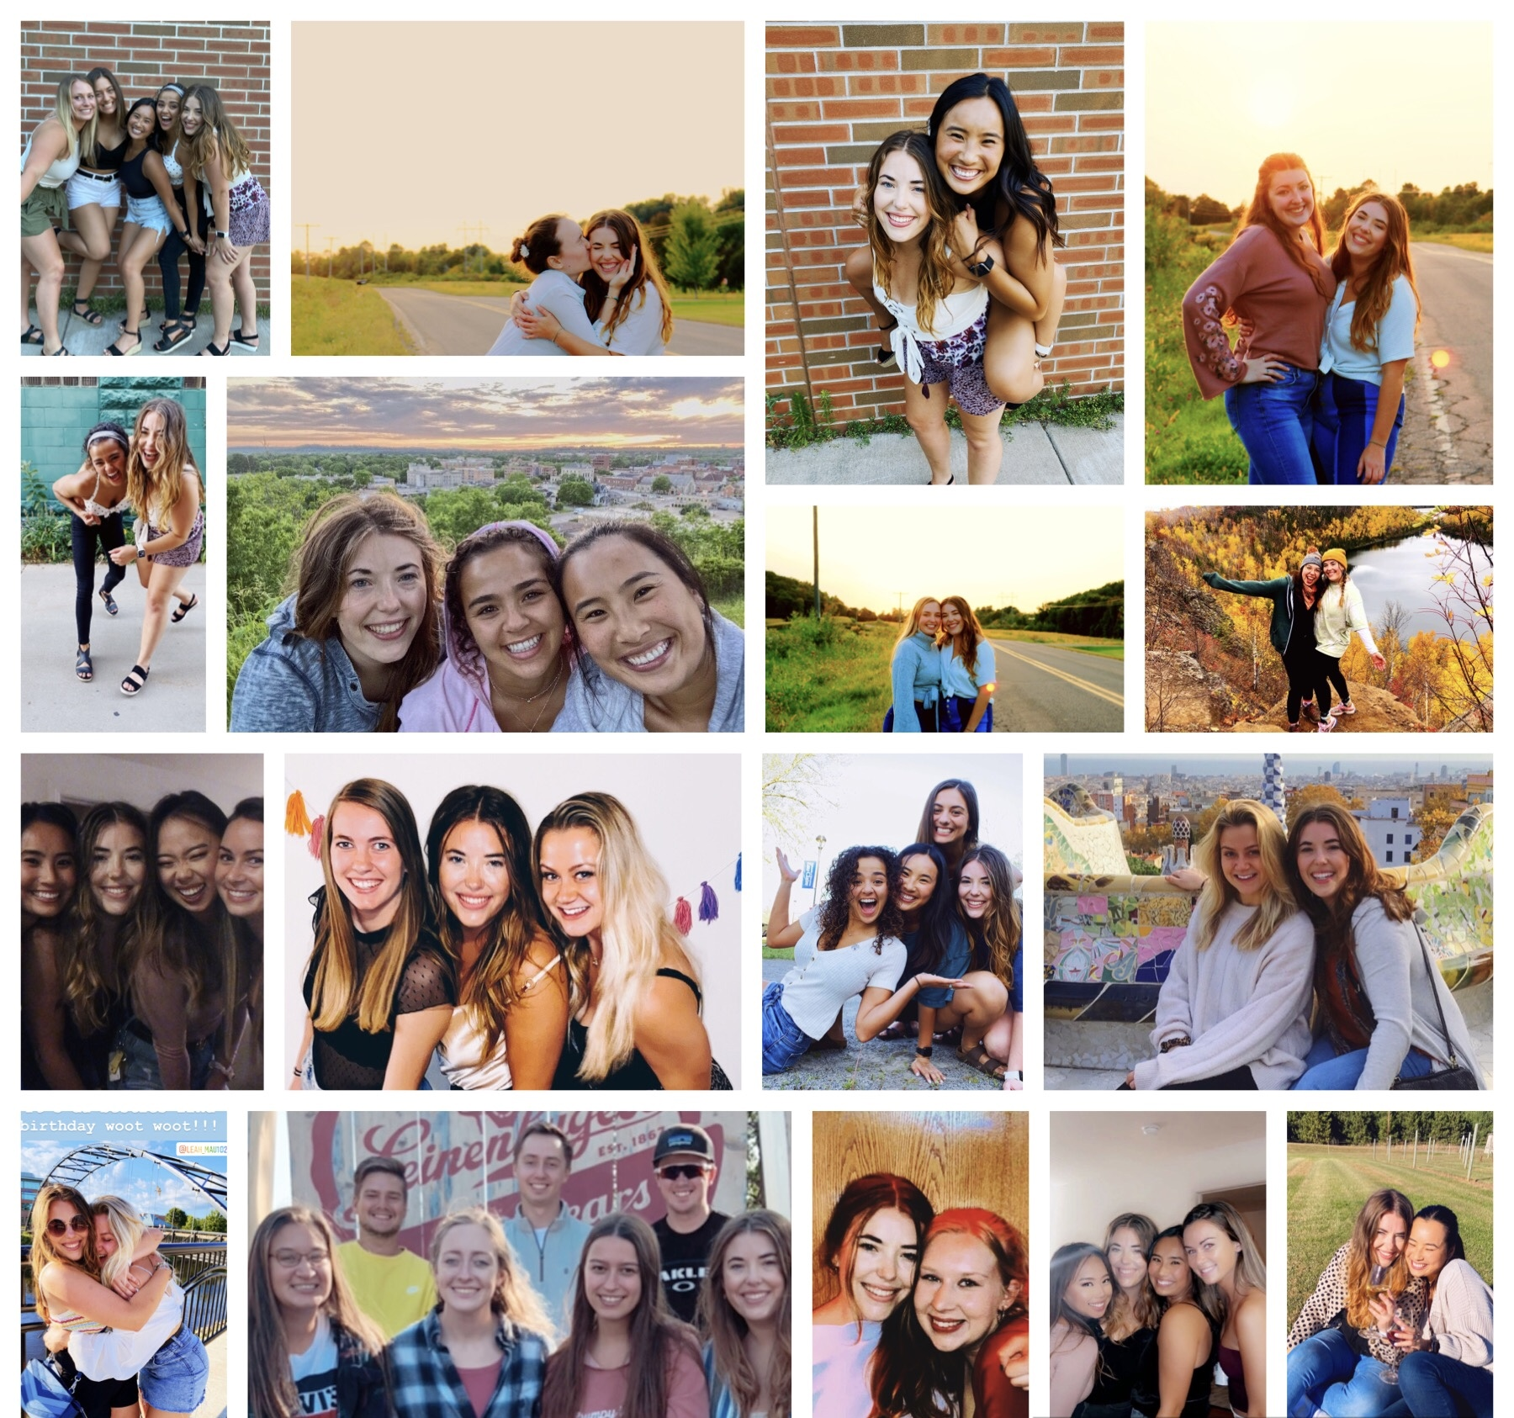
RELATIONSHIPS
Family
Friends

Slide 3



Values
Equality & Human Rights
Justice & Peace
Happiness & Understanding
Kindess & Love
Adventure & Curiosity
Notes:
Value:
Equality and peace
Adventure
Human Rights and Justice
Happiness and Understanding

Slide 4

THOUGHTS & IDEAS

Slide 5
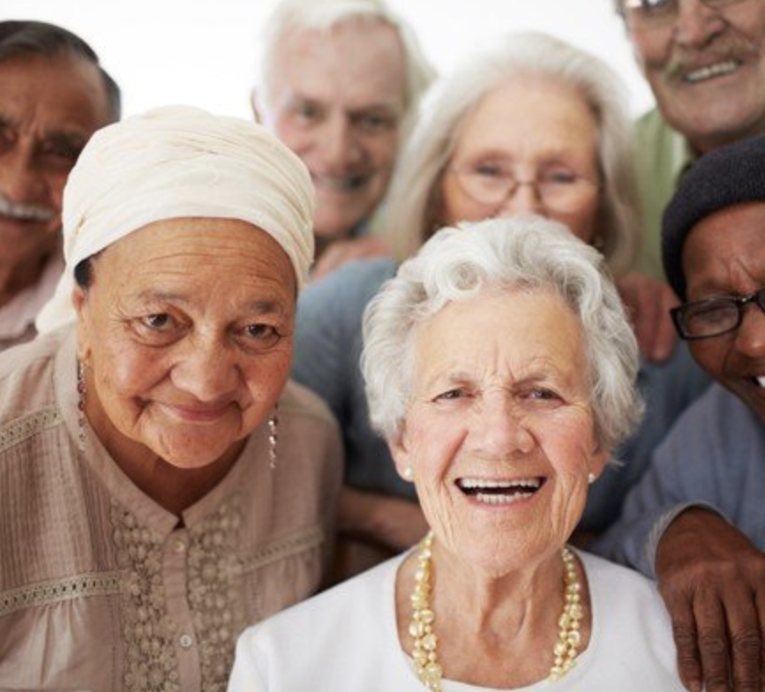
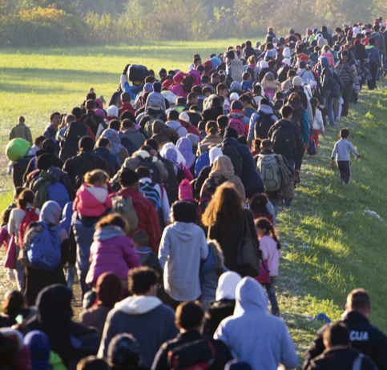
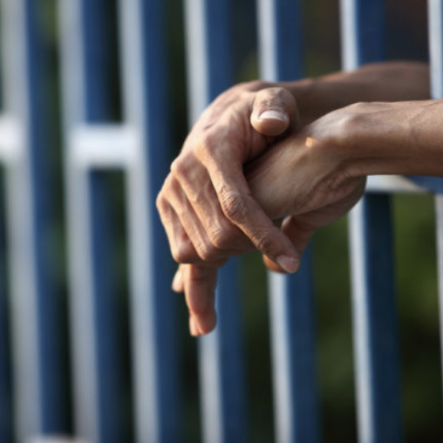
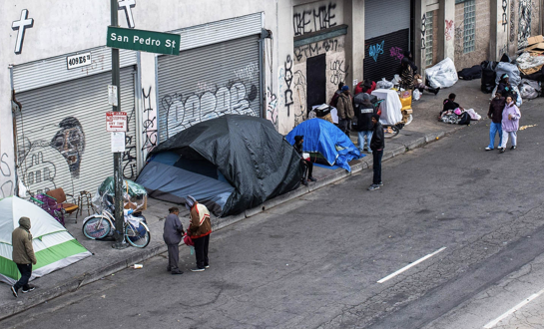
MY MISSION
Notes:
Photos: https://torontocaribbean.com/the-wisdom-of-elders-why-it-is-important-to-have-a-team-of-elders-in-your-circle/
https://source.wustl.edu/2016/09/cost-incarceration-u-s-1-trillion/
https://www.wired.com/story/coronavirus-covid-19-homeless/
https://www.britannica.com/story/whats-the-difference-between-a-migrant-and-a-refugee

Slide 6
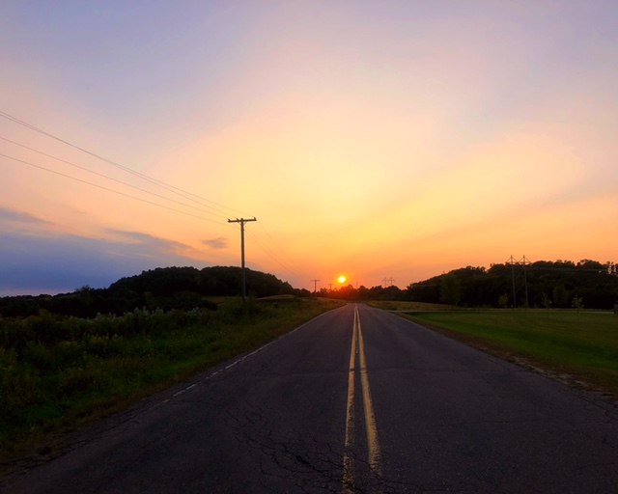
ALLIE ULNESS
EVERYTHING HAPPENS FOR A REASON
LIFE IS A HIGHWAY

Slide 7
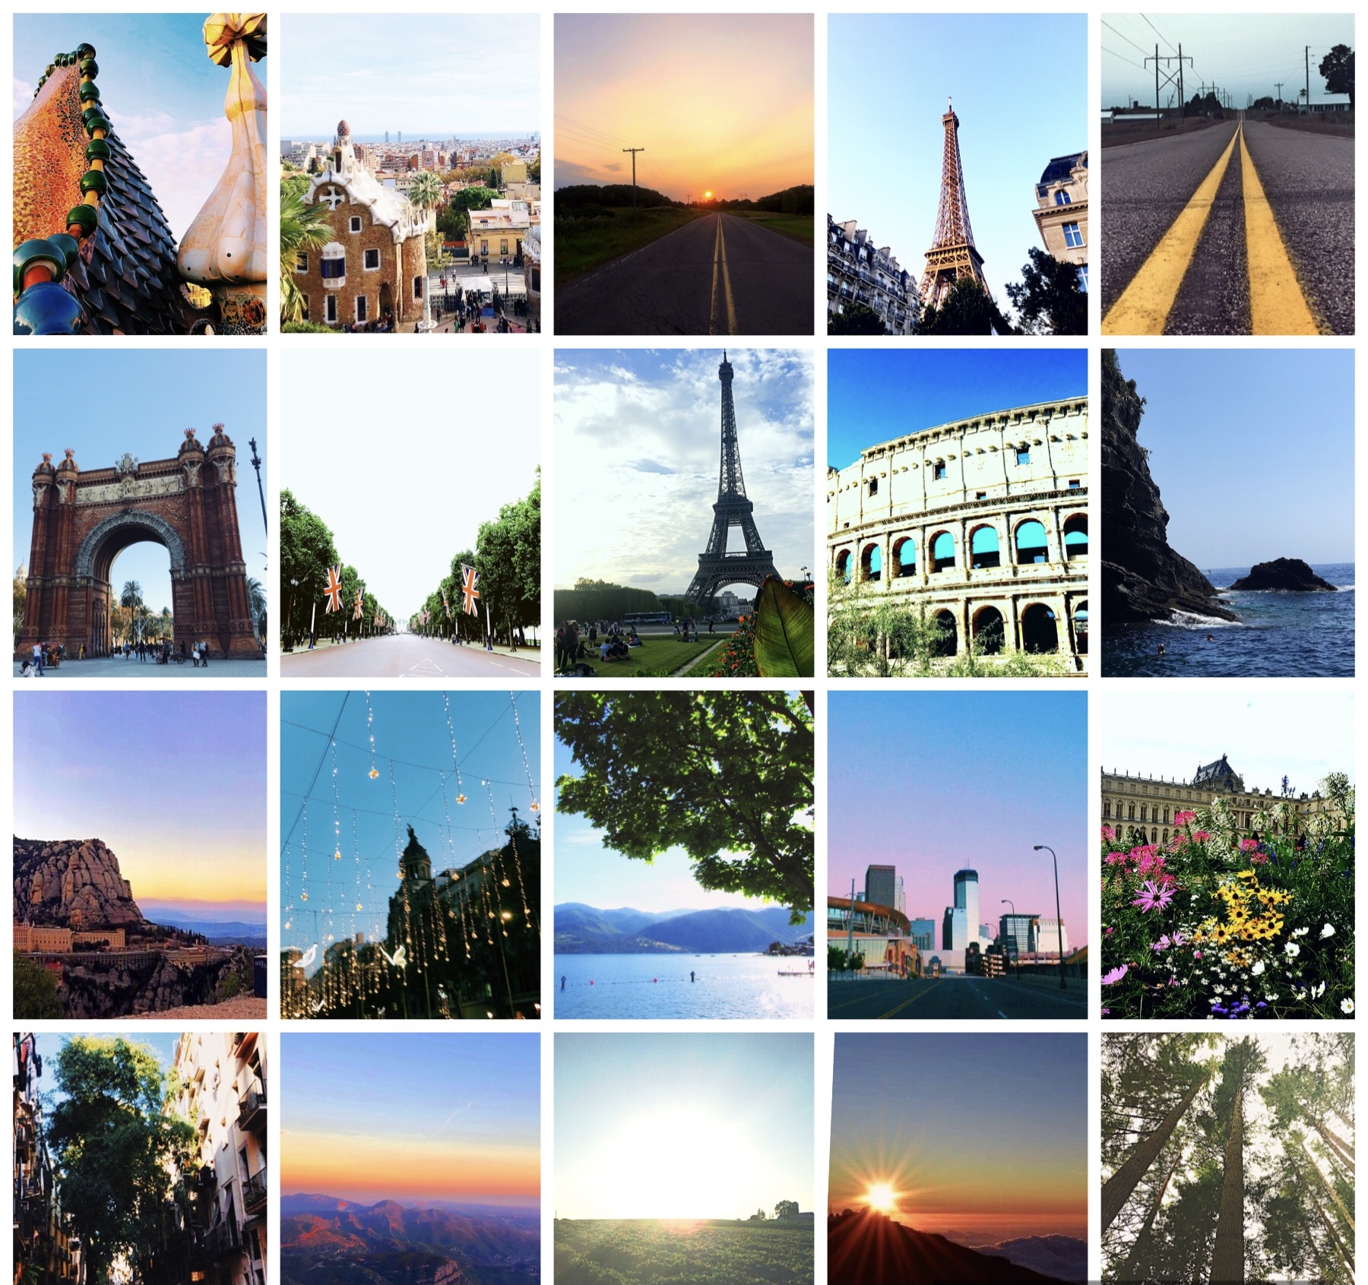
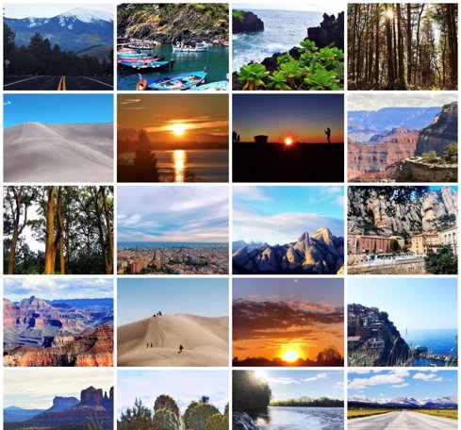
Notes:
My passion just wanted to share some photos.

